Slide 1





Regular Expressions
/^Hel{2}o\s*World\n$/
SoftUni Team
Technical Trainers
Software University
http://softuni.bg

Slide 2

Table of Contents
Regular Expressions
Characters
Operators
Constructs
Regular Expressions in C#
Helpful Resources

Slide 3
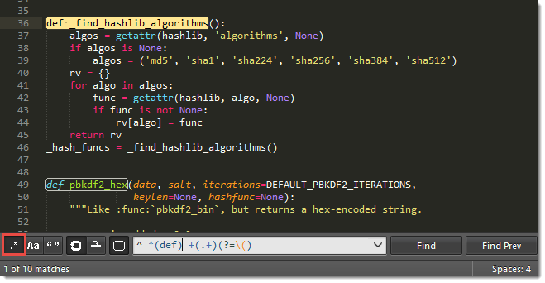
Regular Expressions

Slide 4

Regular Expressions
A regular expression is a sequence of characters that forms a search pattern
Also known as regex, regexp, rational expression
Used for finding and matching certain parts of strings
E.g. all uses of the word "regex"
All strings that correspond to the expression (also know as pattern) are matched
For example A[\w]+ matches all words in a text
that start with A

Slide 5
Search Patterns
Search patterns describe what should be matched
For example, is read as:
Starts with the literal +
Followed by 359
Followed by 9 symbols from in the range 0…9
\+359[0-9]{9}
+61948228831222 – Dick
+359882021853 – Tanio
+2394818322 – Chai Pyong
+9738418 2838 – Nashmat
+359896923312 – Pesho

Slide 6

Regular Expression Syntax

Slide 7

Character Escapes

Slide 8
Character Escapes
Character | Description | Example
\t | Matches a tab
\n | Matches a new line
\u0000 | Matches a Unicode character (e.g. \u0065 is lowercase e)
\ | Matches a literal character (e.g. \. matches a dot .)
This is SPARTA!
The quick brown fox
jumped over
the lazy dog.
Eloquent elf
Interesting. Will look into.

Slide 9

Character Escapes
Live Demo

Slide 10

Character Classes

Slide 11
Character Classes
[character_group] - Matches any single character in character_group
E.g. [nvj] matches any character that is either n, v or j
[^character_group] - Negation: Matches any single character that is not in character_group
E.g. [^abc] – matches any character that is not a, b or c
node.js v0.12.2
Abraham Lincoln

Slide 12
Character Classes (2)
[first-last] - Character range: Matches any single character in the range from first to last
E.g. [0-9] matches any digit frm 0 to 9
. - Matches any single character except \n
In 1519 Leonardo da Vinci died at the age of 67.
Dot matches everything except new line.

Slide 13
Character Classes (3)
\w – Matches any word character (a-z, A-Z, 0-9, _)
\W – Matches any non-word character (the opposite of \w)
\s – Matches any white-space character
\S – Matches any non-white-space character (opposite of \s)
\d – Matches any decimal digit
\D – Matches any non-digit character (opposite of \d)
aBcd 09_ &*^ Ю-Я
aBcd 09_ &*^ Ю-Я

Slide 14
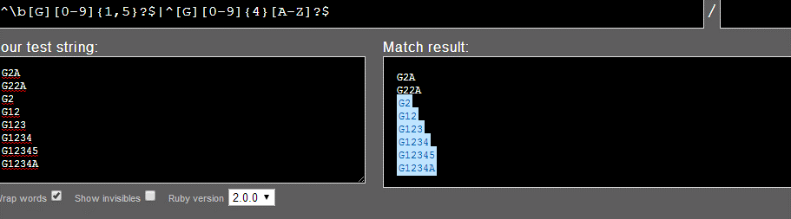
Character Classes
Live Demo

Slide 15

Quantifiers

Slide 16
Quantifiers
* - Matches the previous element zero or more times
+ - Matches the previous element one or more times
? - Matches the previous element zero or one time
+359885976002
+
\+\d*
=>
+359885976002
+
\+\d+
=>
\+\d?
=>
+359885976002
+

Slide 17
Quantifiers (2)
{n} - Matches the previous element exactly n times
{n,} - Matches the previous element at least n times
{n,m} - Matches the previous element at least n times, but no more than m times
\+\d{5}
=>
+359885976002
\+\d{5,}
=>
+359885976002
\+\d{5,7}
=>
+359885976002

Slide 18

Quantifiers
Live Demo

Slide 19
Anchors

Slide 20

Anchors
^ - The match must start at the beginning of the string or line
$ - The match must occur at the end of the string or before \n
Example – username validation pattern:
Note: Test one by one, $ asserts string end
^\w{6,12}$
jeff_butt
short
johnny
too_long_username
!lleg@l_ch@rs

Slide 21
Anchors
\b - The match must occur on a boundary between a \w (alphanumeric) and a \W (non-alphanumeric) character
\B - The match must not occur on a boundary between a \w (alphanumeric) and a \W (non-alphanumeric) character
\b\w{4}\b
=>
Text jumping is cool.
\b\w{4}\b
=>
Text jumping is cool.

Slide 22

Anchors
Live Demo

Slide 23

Grouping Constructs
\d{2}-(\w{3})-\d{4}

Slide 24
Grouping Constructs
(subexpression) - captures the matched subexpression and assigns it a number
(?<name>subexpression) - Captures the matched subexpression into a named group
\d{2}-(\w{3})-\d{4}
=>
22-Jan-2015
\d{2}-(?<month>\w{3})-\d{4}
=>
22-Jan-2015
Names the captured group 'month'

Slide 25
Grouping Constructs (2)
(?:subexpression) – Defines a non-capturing group
(?<=subexpression) – Positive lookbehind
(?<!subexpression) – Negative lookbehind
^(?:Hi|hello),\s*(\w+)$
=>
Hi, Peter
(?<=#)\d{1,4}
=>
Gladstone #354
(?<![0-9\-])\d+
=>
Gladstone St. #-2 -123 354 2

Slide 26
Grouping Constructs (3)
(?=subexpression) – Positive lookahead
(?!subexpression) – Negative lookahead
.*?(?=\!)
=>
This is not a drill!
\b\w+\b(?![\w?])
=>
Is this a drill?

Slide 27
Grouping Constructs
\d{2}-(\w{3})-\d{4}
Live Demo

Slide 28
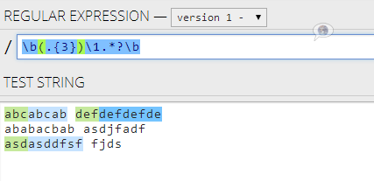
Backreference Constructs

Slide 29
Backreference Constructs
\number – matches the value of a numbered subexpression
\k<name> – matches the value of a named expression
22-12-2015
05/08/2016
\d{2}(-|\/)\d{2}(\1)\d{4}
=>
References an already captured group by index
22-12-2015
05/08/2016
\d{2}(?<del>|\/)\d{2}(\k<del>)\d{4}
=>
Reuses an already captured group by index

Slide 30
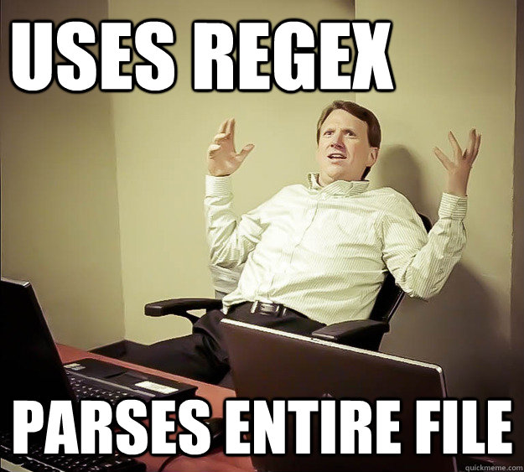
Backreference Constructs
Live Demo

Slide 31
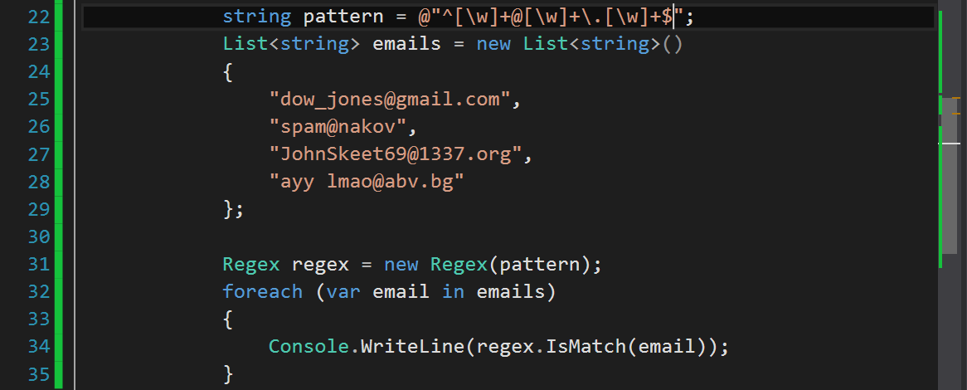
Regular Expressions in C#
Using Built-In Regex Classes

Slide 32
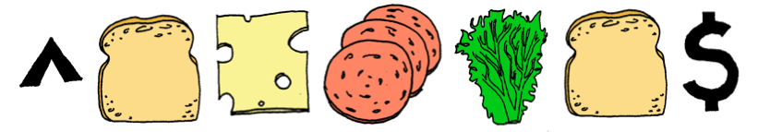
Regex in C#
C# supports a built-in regular expression class - Regex
Located in System.Text.RegularExpressions namespace
Accepts the pattern as argument
string pattern = @"A[\w]+";
Regex regex = new Regex(pattern);

Slide 33
Validating String By Pattern
IsMatch(string text) – determines whether the text matches the pattern
string text = "Today is 2015-05-11";
string pattern = @"\d{4}-\d{2}-\d{2}";
Regex regex = new Regex(pattern);
bool containsValidDate = regex.IsMatch(text);
Console.WriteLine(containsValidDate); // True

Slide 34
Checking for a Single Match
Match(string text) – returns the first match that corresponds to the pattern
string text = "Nakov: 123";
string pattern = @"([A-Z][a-z]+): (\d+)";
Regex regex = new Regex(pattern);
Match match = regex.Match(text);
Console.WriteLine(match.Groups.Count); // 3
Console.WriteLine("Matched text: \"{0}\"", match.Groups[0]);
Console.WriteLine("Name: {0}", match.Groups[1]); // Nakov
Console.WriteLine("Number: {0}", match.Groups[2]); // 123

Slide 35
Checking for Matches
Matches(string text) – returns a collection of matching strings that correspond to the pattern
string text = "Nakov: 123, Branson: 456";
string pattern = @"([A-Z][a-z]+): (\d+)";
Regex regex = new Regex(pattern);
MatchCollection matches = regex.Matches(text, pattern);
Console.WriteLine("Found {0} matches", matches.Count);
foreach (Match match in matches)
{
Console.WriteLine("Name: {0}", match.Groups[1]);
}
// Found 2 matches
// Name: Nakov
// Name: Branson

Slide 36
Replacing With Regex
Replace(string text, string replacement) – replaces all strings that match the pattern with the provided replacement
string text = "Nakov: 123, Branson: 456";
string pattern = @"\d{3}";
string replacement = "999";
Regex regex = new Regex(pattern);
string result = regex.Replace(text, replacement);
Console.WriteLine(result);
// Nakov: 999, Branson: 999

Slide 37

Splitting With Regex
Split(string text) – splits the text by the pattern
Returns string[]
string text = "1 2 3 4";
string pattern = @"\s+";
string[] results = Regex.Split(text, pattern);
Console.WriteLine(string.Join(", ", results)); // 1, 2, 3, 4

Slide 38
Matching Strings – Example
string pattern = @"A[\w]+";
string text = "Gosho Pesho Anatoli Penio Asen";
Regex regex = new Regex(pattern);
Match match = regex.Match(text);
Console.WriteLine(match); // Anatoli
MatchCollection matches = regex.Matches(text);
foreach (var match in matches)
{ Console.WriteLine(match);
}
// Anatoli, Asen

Slide 39
Email Validation – Example
string pattern = @"^[\w-]{4,12}@[\w\-]{2,}\.[a-zA-Z]{1,}$";
List<string> emails = new List<string>()
{
"dow_jones@gmail.com",
"spam@nakov",
"JohnSkeet69@1337.org",
"ayy lmao@abv.bg"
};
Regex regex = new Regex(pattern);
foreach (var email in emails)
{
Console.WriteLine(regex.IsMatch(email));
}

Slide 40
Helpful Resources
https://regex101.com and http://regexr.com – websites to test Regex using different programming languages
http://regexhero.net – website to test Regex using C#
http://msdn.microsoft.com/en-us/library/az24scfc(v=vs.110).aspx – quick reference for Regex from Microsoft
http://regexone.com – Interactive tutorials for Regex
http://www.regular-expressions.info/tutorial.html – a comprehensive tutorial on regular expressions

Slide 41
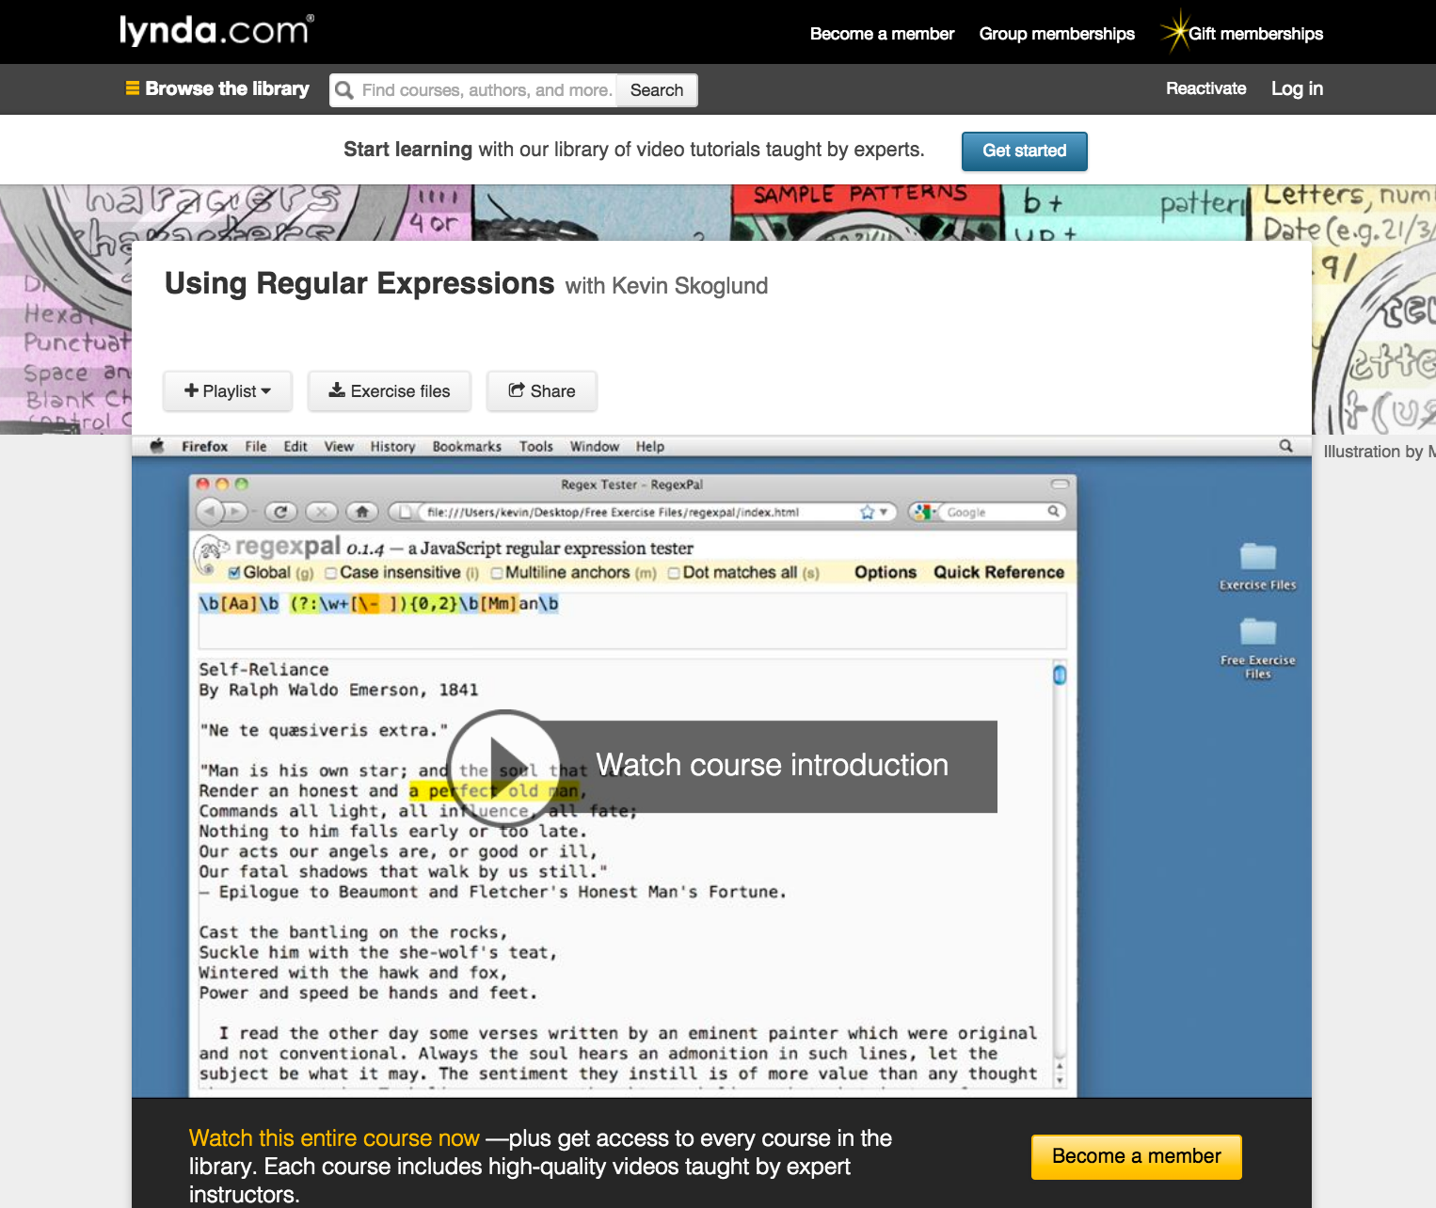
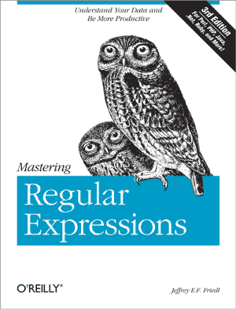
Helpful Resources (2)

Slide 42

Exercises in Class

Slide 43

Summary
Regular expressions describe patterns for
searching through strings of text
Define special characters, operators and
constructs for building complex patterns
Powerful tool for extracting specific data from text or validating strings (e.g. email/username validator)
C# provides a built-in Regex class
Supports matching, validating, splitting and replacing strings by a pattern

Slide 44









Regular Expressions
https://softuni.bg/courses/advanced-csharp

Slide 45
License
This course (slides, examples, demos, videos, homework, etc.) is licensed under the "Creative Commons Attribution-NonCommercial-ShareAlike 4.0 International" license
Attribution: this work may contain portions from
"C# Fundamentals – Part 1" course by Telerik Academy under CC-BY-NC-SA license
"C# Fundamentals – Part 2" course by Telerik Academy under CC-BY-NC-SA license

Slide 46





Free Trainings @ Software University
Software University Foundation – softuni.org
Software University – High-Quality Education, Profession and Job for Software Developers
softuni.bg
Software University @ Facebook
facebook.com/SoftwareUniversity
Software University @ YouTube
youtube.com/SoftwareUniversity
Software University Forums – forum.softuni.bg

